Slide 1


I-Sports : WEBSITE for sports events
Presented by :- HiteshKumar Prajapati(181200116044)
Internal Guide :- Prof. Ami Pandya

Slide 3
Abstract:-
For sports events like state, the national level which held in college/school will use this application to manage all types of sports events. So that participants will get all information of sport time, venue, location, accodamation, and contact details, etc. The proposed system consists of actors they are Admin and User. Admin can post their details like event location, day, type of events, and some common details. They are multiple admins can post details in this system. Users can view the details of the event. And they can search any type of category like date, year, location, event, etc. they can also view the last 10 years record details via this system.

Slide 4
Solutions:-
Existing Solution
Its manual process for earlier system.
Its chance to lose our record or data.
If we search any details for old records its take more time consuming process.
We can search only few category details.
Proposed Solution
The proposed system consists to actors they are Admin and User. Admin can post their details like event location, day, type of events and some common details. They are multiple admin can post details in this system.
User can view the events details. And they can search any type of category like date, year, location, event and etc. they can also view last 10 years records details via this system.
Here National level, District level, Zonal level sport details also update every time.

Slide 5
System Specifications:-
Software Requirements: -
Front End : HTML5, CSS3, Bootstrap
Back End: PHP, MYSQL
Control End: Angular Java Script
PHP Tools:
xampp-win32-5.5.19-0-VC11

Slide 6
student
start
Student login
View event
Student post
Student sports
stop

Slide 7
staff
start
staff login
Create sports
stop

Slide 8
Admin
start
admin login
Create student register
View student details
View/Approval event
stop

Slide 9
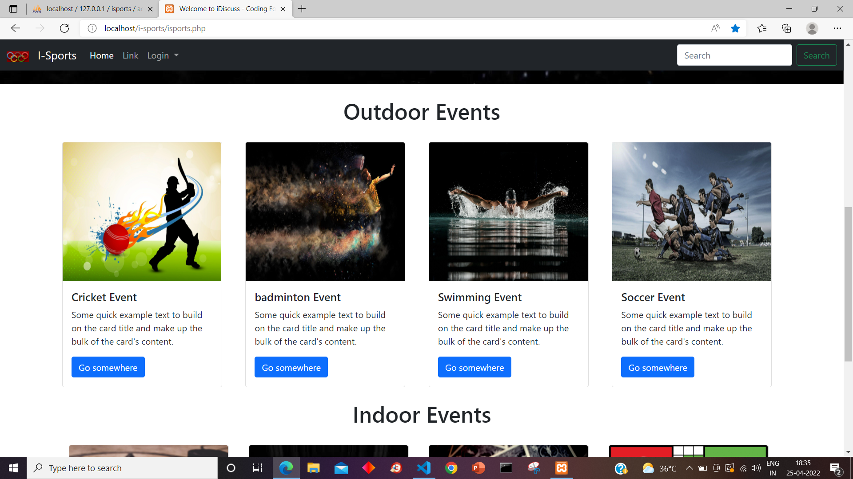
Home Page:-

Slide 10
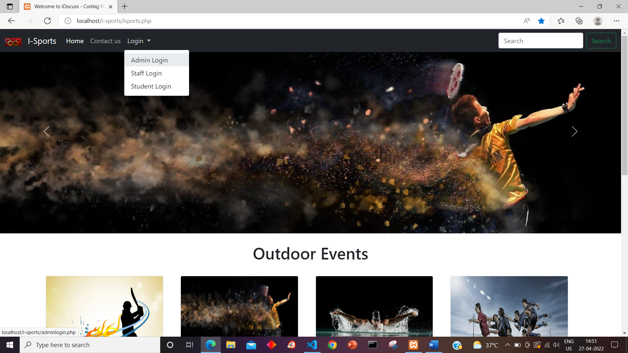
Login Pages:

Slide 11
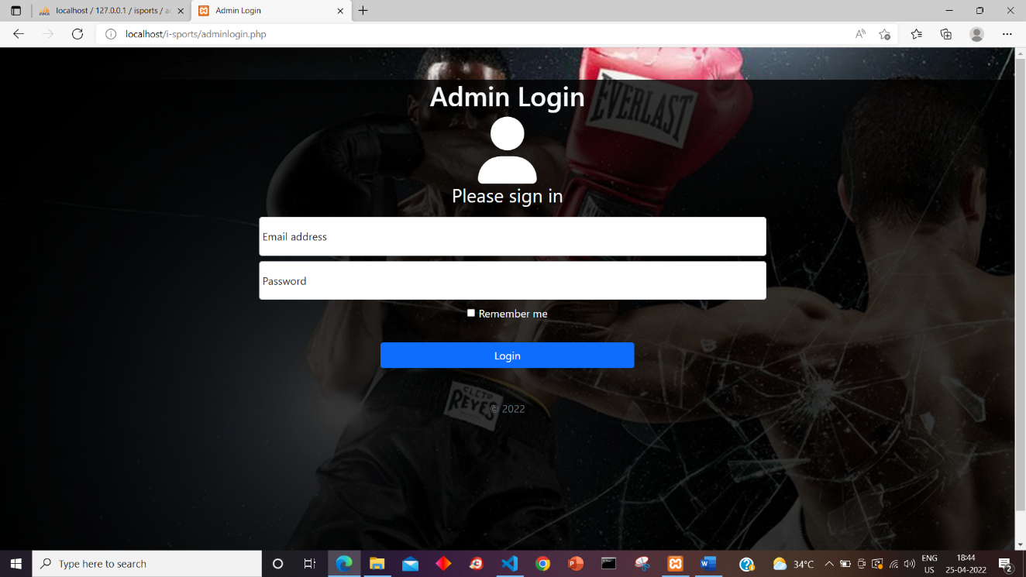
Admin Login Page:

Slide 12
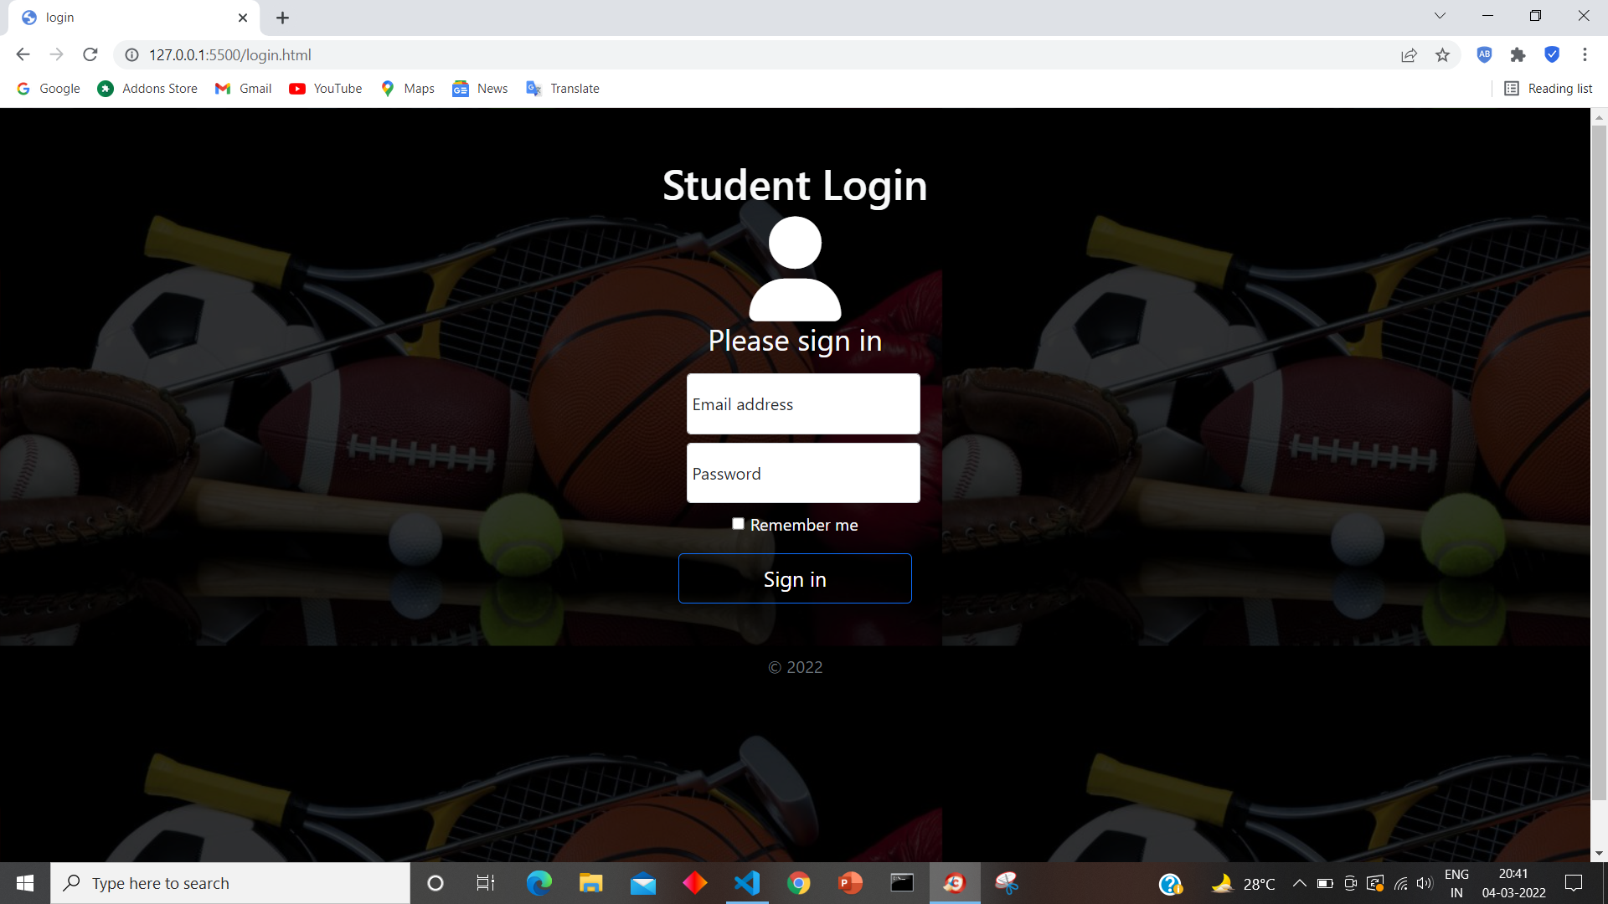
Login Page :-

Slide 13
Admin Home Page :

Slide 14
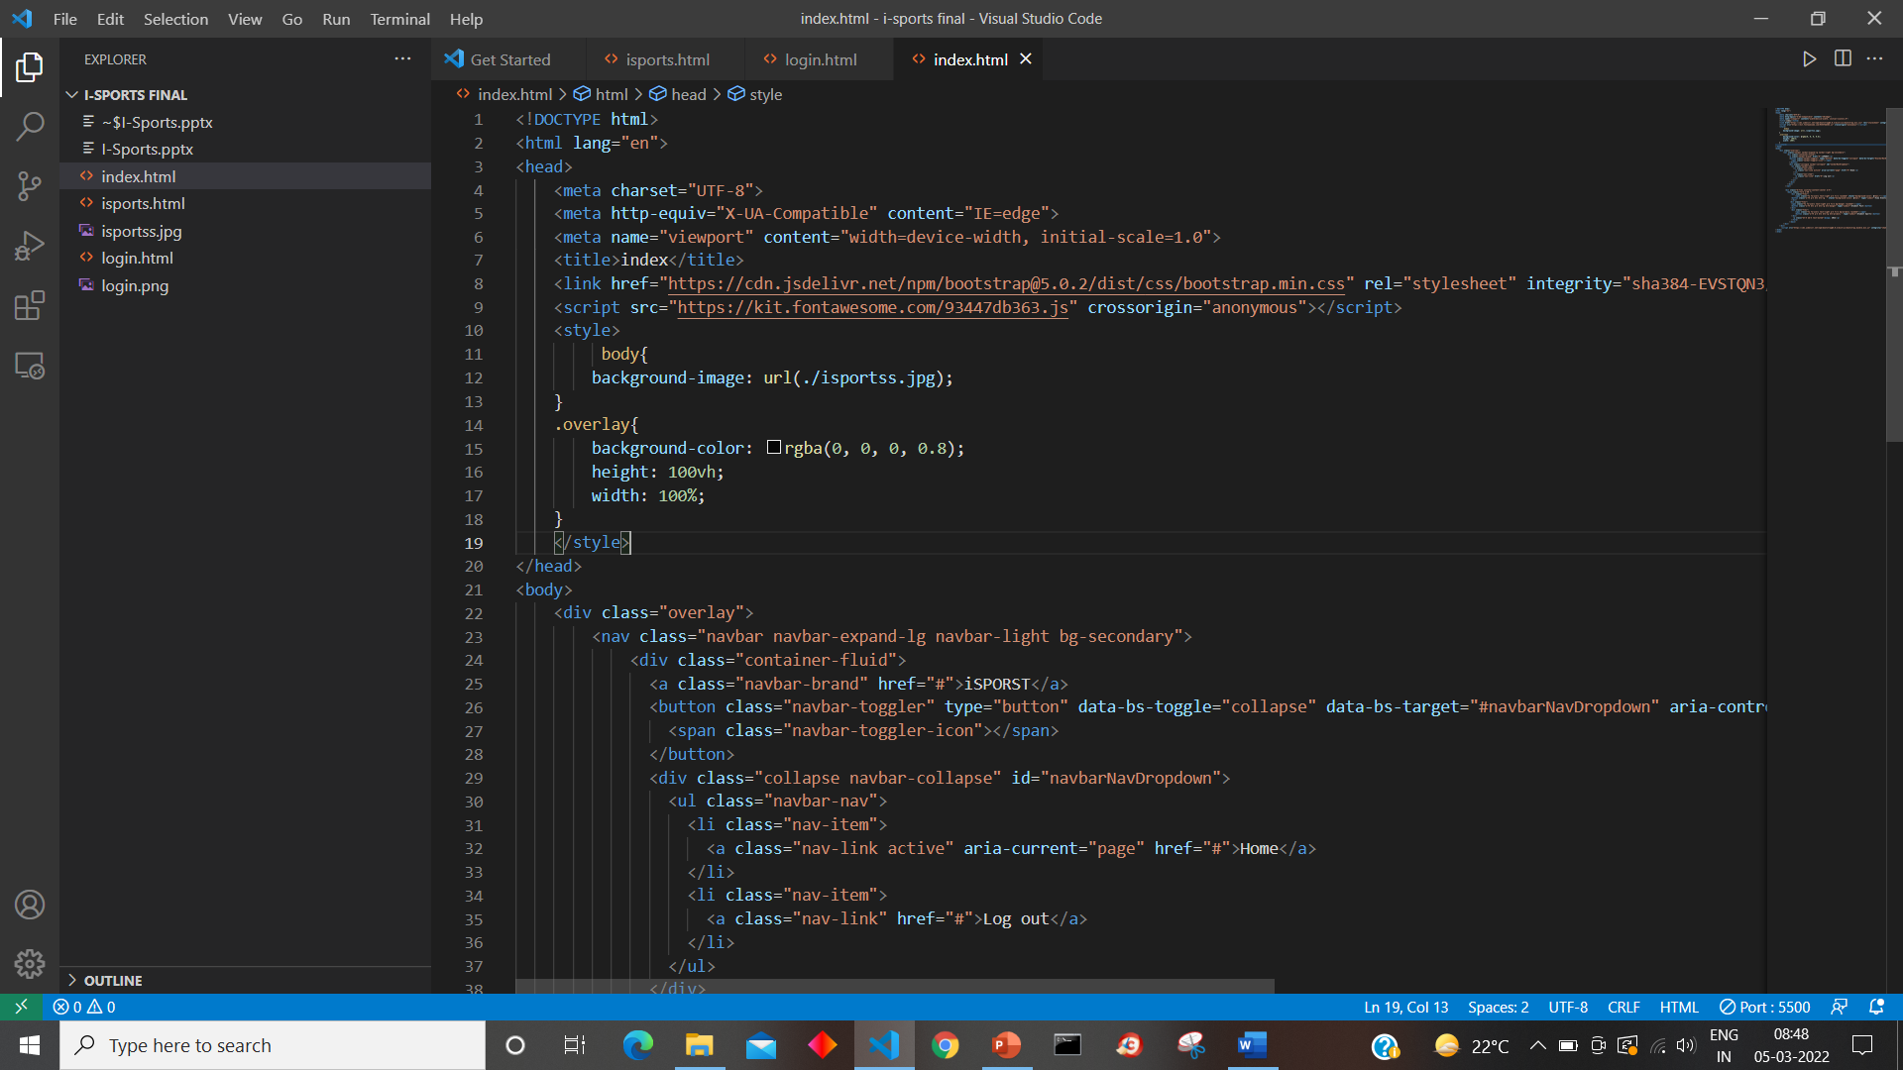
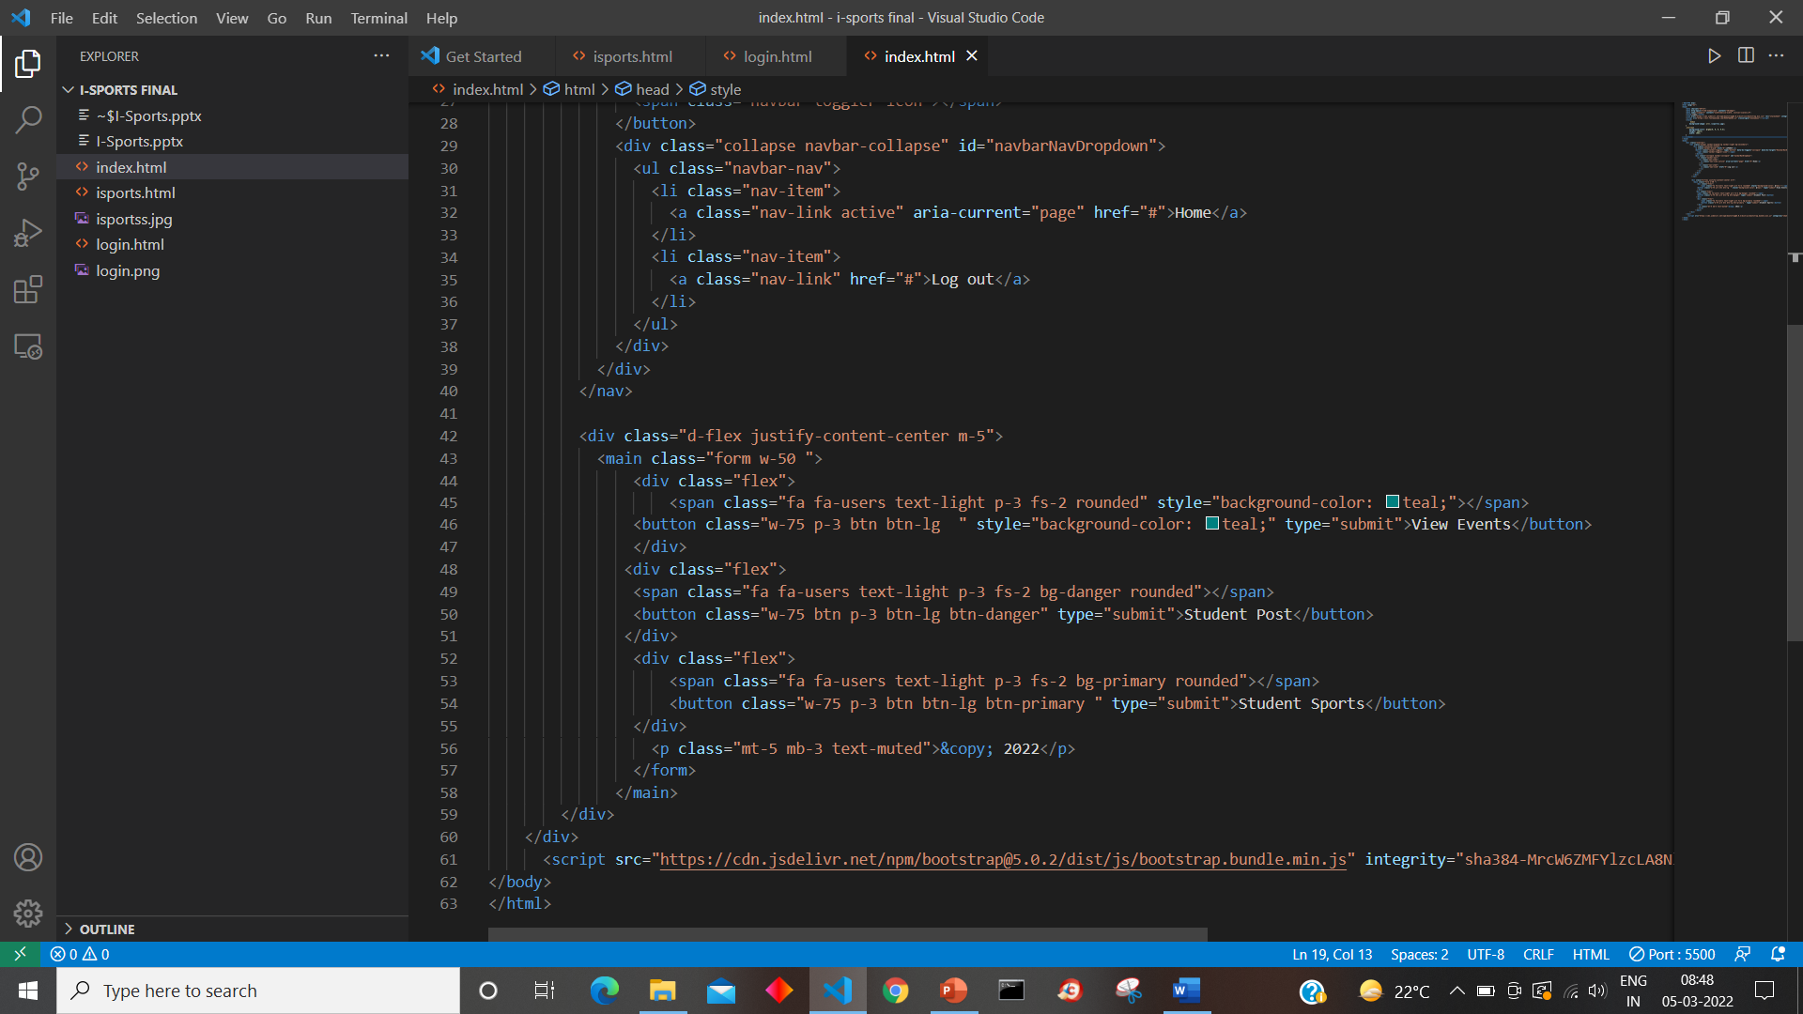
Index Page:-

Slide 15
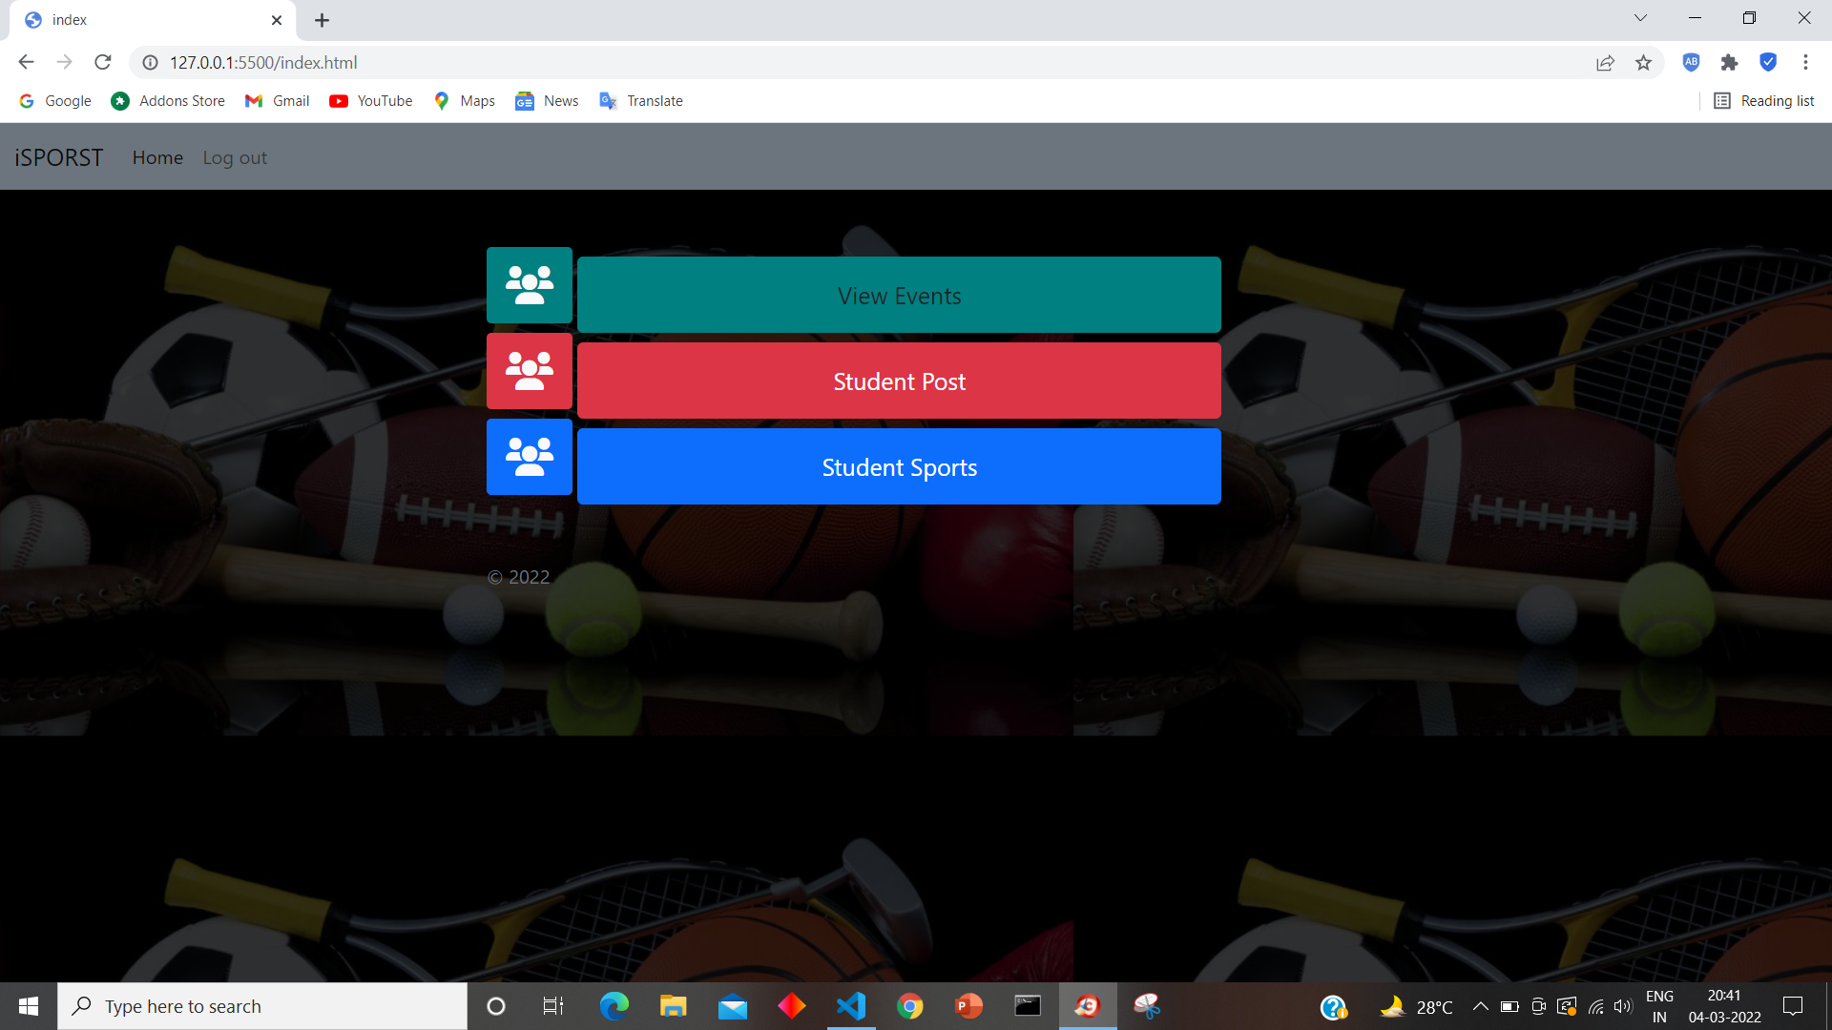
Index.html:-

Slide 16
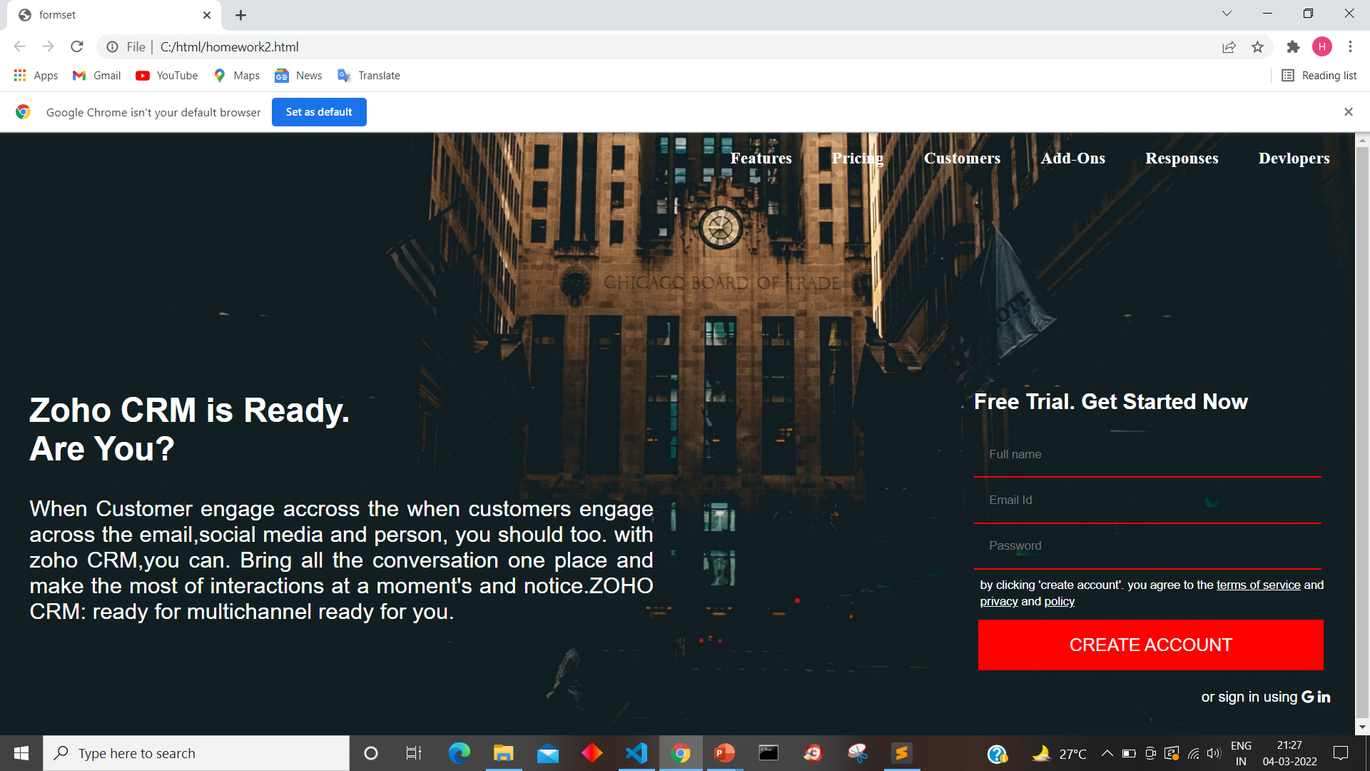
Html TASK:-

Slide 17
System Modules
Admin
(Schools, Colleges, Academies)
Login
User Register
Post contact Details
Approval of all event
User
Login
View Details
Search Records
SMS Alert
Any events alerts

Slide 18
Thank you.

